Slide 1
Climate Summit
Vietnam
D Moutoux

Slide 2
Geographer

Slide 3
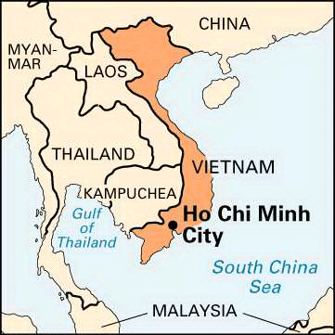
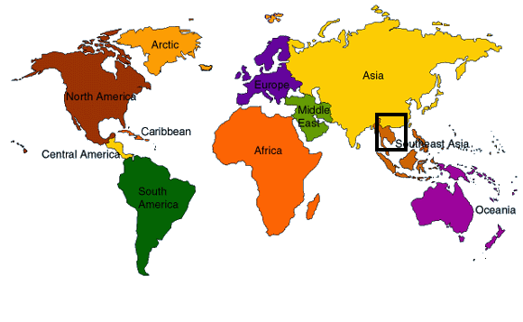
Location
Ho Chi Minh City was formerly known as Saigon

Slide 4
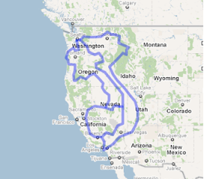
Vietnam Statistics
About 3/4 the land area of California, but almost as long as the whole west coast
Almost 2.5 times the population of California
Only 8% of the GDP (gross domestic product) of California (relatively poor)

Slide 5
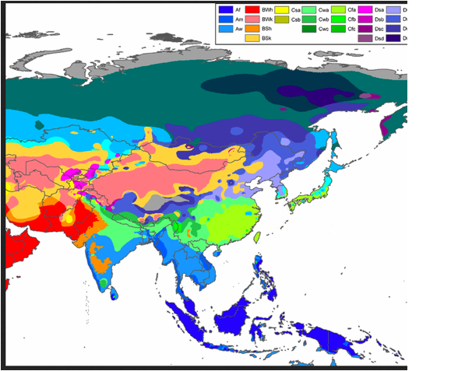
Koeppen Classification
Southern ¾ tropical monsoon & tropical wet & dry
Northern ¼ humid subtropical

Slide 6
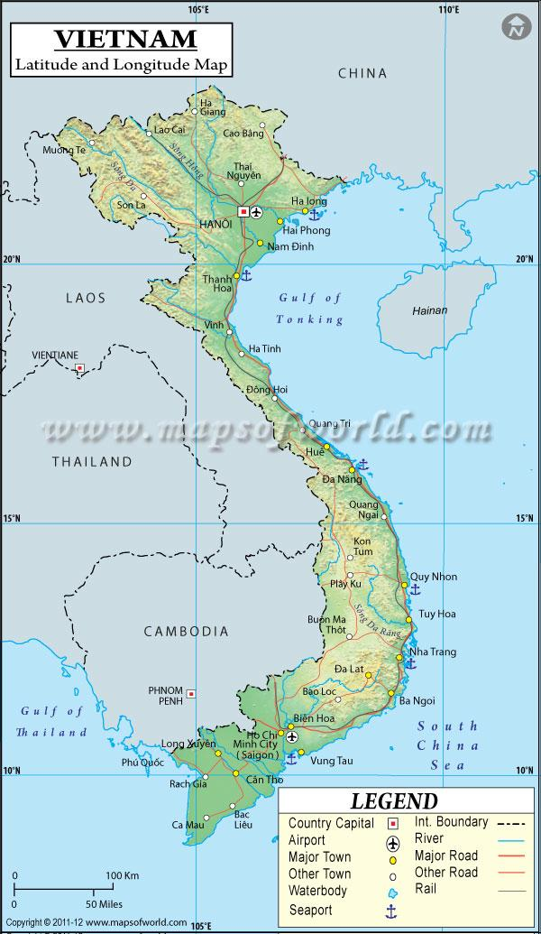
Factors Affecting Climate - Latitude & Coast
8 to 24 degrees North
Mostly in Tropics
3,260 km (~2,000 mile) coastline along east and south

Slide 7
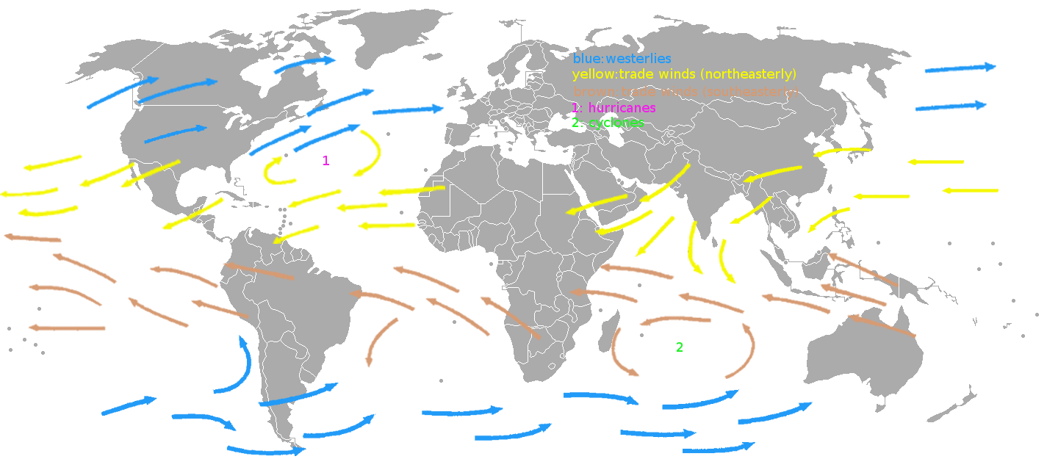
Factors Affecting Climate - Winds
Northeast Trade Winds due to tropical latitude

Slide 8
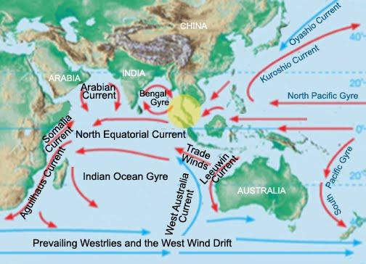
Factors Affecting Climate - Currents
From the Northeast

Slide 9
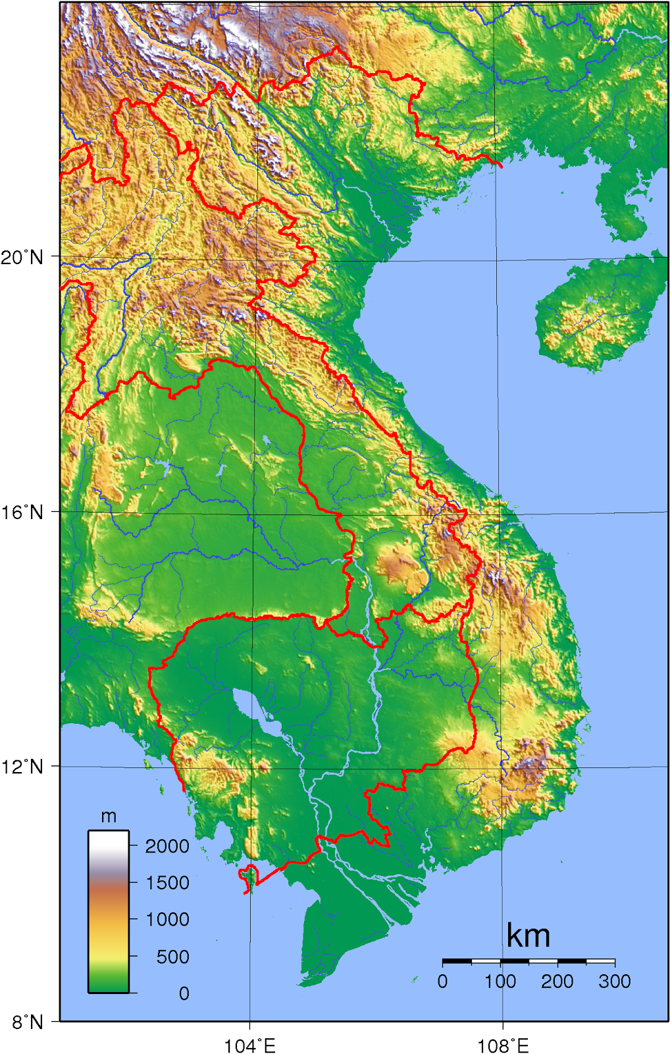
Factors Affecting Climate - Mountains
About 50 km inland from and parallel to the east coast
Maximum height 3143 m (about 10,000 feet)

Slide 10
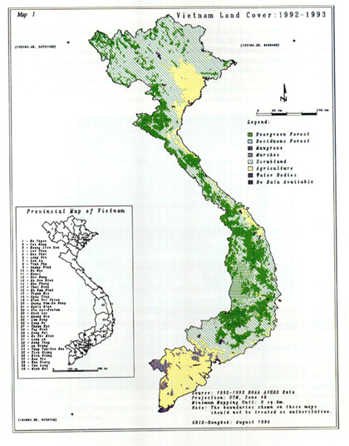
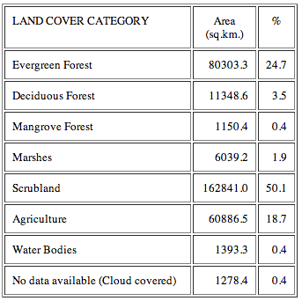
Factors Affecting Climate - Vegetation

Slide 11
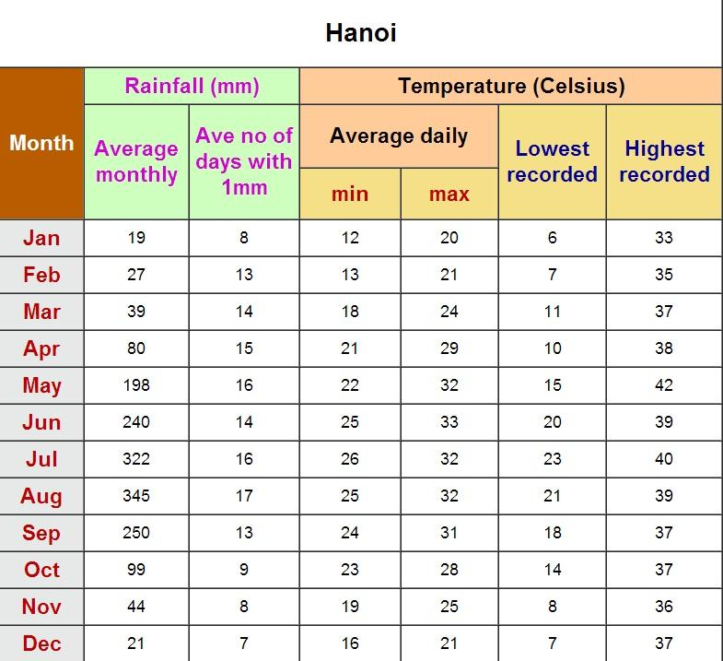
Temperature
Daily Temperature Range = 7 °C (12°F)
Annual Temperature Range = 13 °C (23°F)
Range is both warmer & narrower in tropical regions south of Hanoi

Slide 12
Frost?
No frost … coldest temperature was 6°C (43°F)
Highest recorded temperature was 42°C (108°F)

Slide 13
Why These Temperatures?
Tropical latitude keeps the temperatures warm
Close proximity to the coast and prevailing winds from the east (ocean) keep the temperature range narrow

Slide 14
Precipitation
168 cm/yr (66 in/yr)
All rain
Monsoon season from May through September

Slide 15
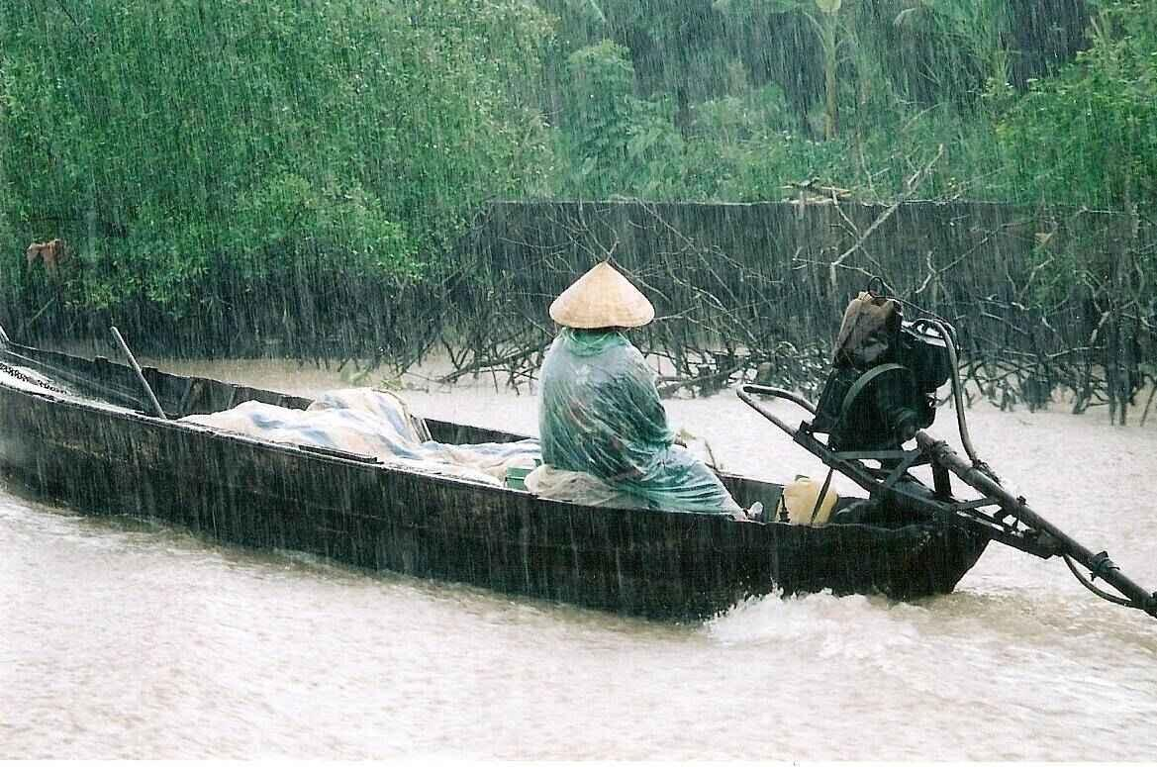
Why This Type of Precipitation?
Rain due to tropical latitude
Monsoon due to equatorial low moving northward during the summer months

Slide 16
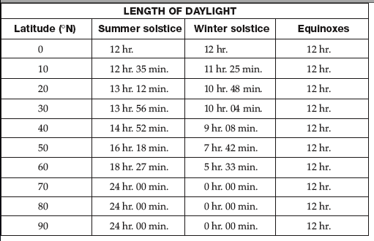
Hours of Daylight
Very long country so ...
In the south, daylight varies by less than 1 hour from Winter to Summer Solstice
In the north, daylight varies by about 3 hours from Winter to Summer Solstice

Slide 17
Meteorologist

Slide 18
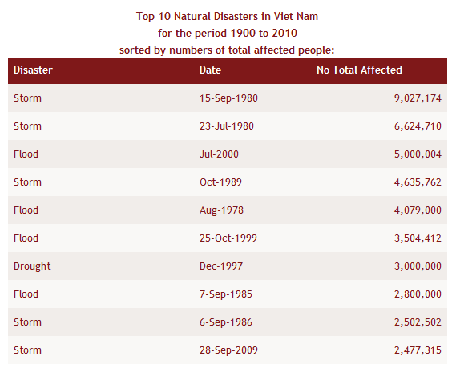
Severe Weather
Usually involves too much water and can affect millions of people.

Slide 19
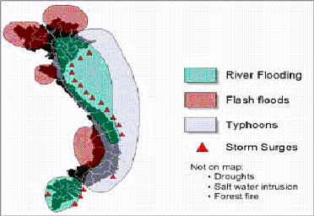
Severe Weather
Monsoons
Typhoons
Droughts

Slide 20
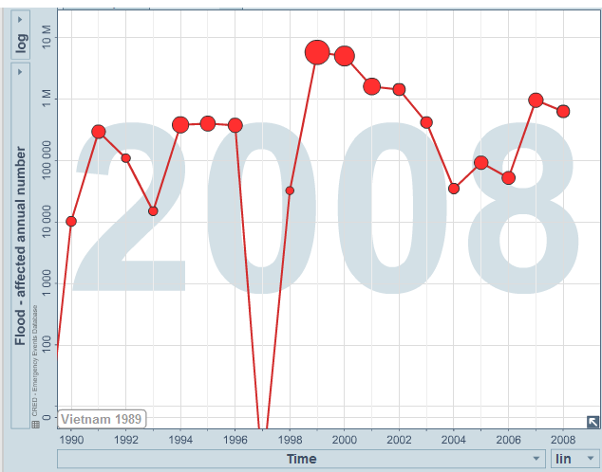
Monsoon Season
Several months each year
Saturate earth
Flood rivers and deltas
Impacts 10,000 to 10,000,000 people annually

Slide 21
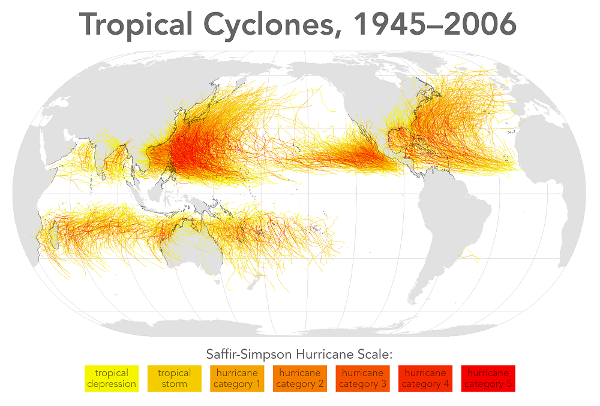
Typhoons
Common in the western Pacific and East Sea

Slide 22
Tropical Cyclones (Typhoons & Storms)
About 11 per year in the East Sea
About 7 per year make landfall in Vietnam
Minimum of 4 in 1966
Maximum of 18 in 1973

Slide 23
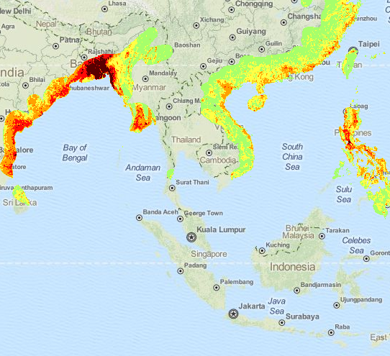
Typhoons
High potential along the central and northern coasts

Slide 24
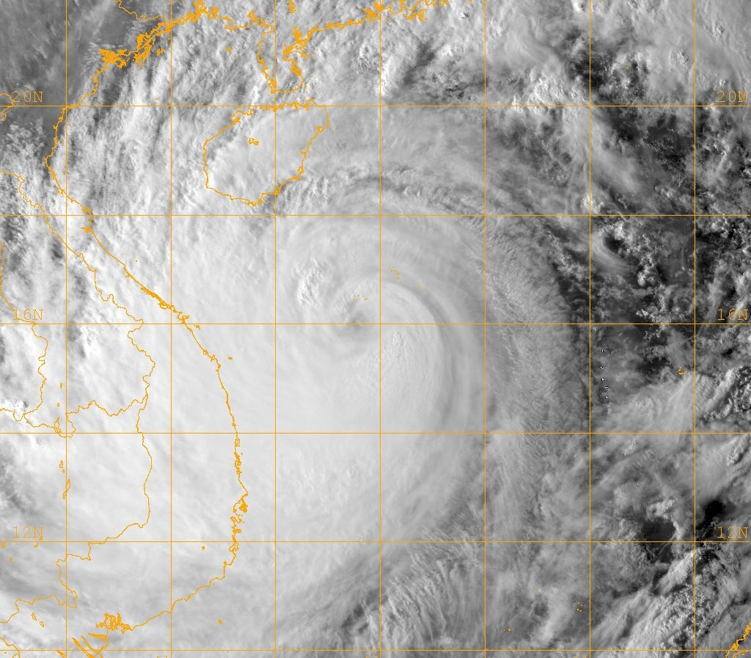
What is a Typhoon?
Identical to a hurricane
Tropical low pressure system
Organized system of thunderstorms
Sustained winds of at least 74 mph

Slide 25
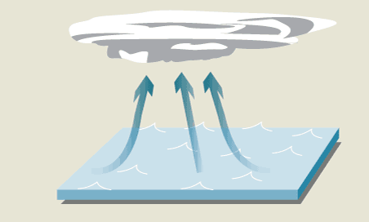
How Do Typhoons Form?
Start as tropical thunderstorms
Strong winds pull in moisture from the ocean

Slide 26
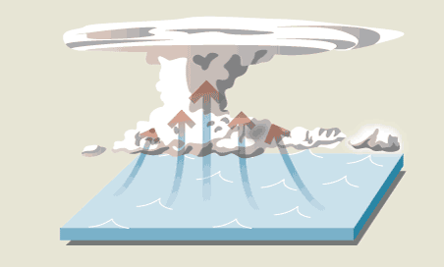
How Do Typhoons Form?
Moisture converted to heat
Heat draws more air to the center
Additional air causes more evaporation

Slide 27
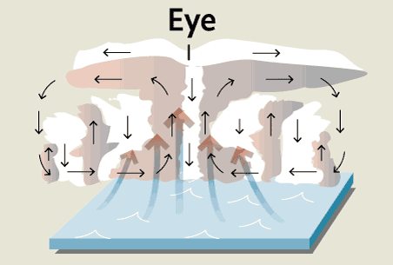
How Do Typhoons Form?
Heat and air flow toward the eye
Air sinks in the eye creating clear skies

Slide 28
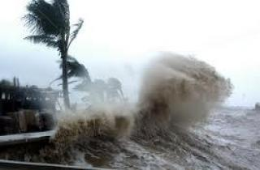
Consequences of Typhoons
Sea levels can rise several meters
Cause storm surges
Inundate low-lying cropland
Waves damage sea dykes
Winds destroy buildings
Flash floods in mountains
Extensive flooding along rivers
100’s of deaths annually

Slide 29
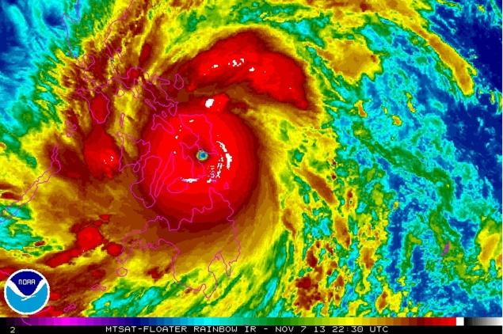
Super Typhoon Haiyan
November 2013
Highest recorded sustained wind speed: 315 kph (195 mph)
Caused thousands of deaths in Philippines
Triggered evacuation of 800,000 in Vietnam

Slide 30
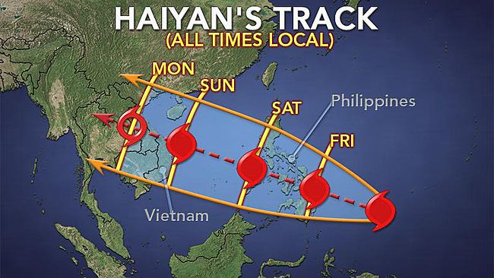
Super Typhoon Haiyan
Gusts of 145 kph (91 mph)
Total rainfall in excess of 18 inches
Resulted in 10 deaths and 4 missing
Several hundred houses destroyed in Hanoi
Several thousand trees uprooted

Slide 31
Effects of El Niño & La Niña
World Health Organization (WHO) asserts that South Asia is at significant risk from ENSO-related natural disasters due to
large climatic changes
large populations
high population densities

Slide 32
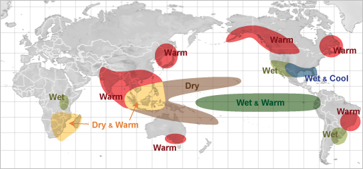
Effect of El Niño - December through February
North - Warm
South & Central - Dry & Warm
Impacts smaller streams used to irrigate rice during the winter dry season.

Slide 33
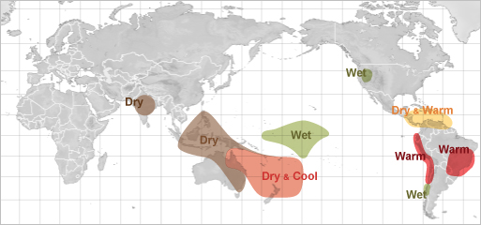
Effect of El Niño - June through August
No Significant Effects

Slide 34
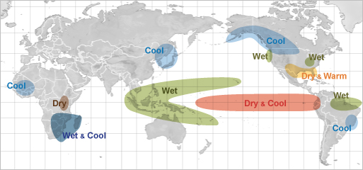
Effect of La Niña - December through February
North & Cental - No Impact
South & Central - Wet

Slide 35
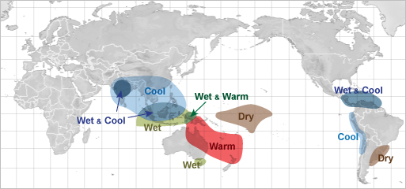
Effect of La Niña - June through August
Mostly Cooler Everywhere

Slide 36
Climatologist

Slide 37
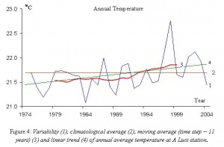
Changing Temperature
0.5 to 0.7 C increase from 1958 to 2007.
Winter temperatures increased more than summer.
Temperature in the north increased more than temperatures in the south

Slide 38
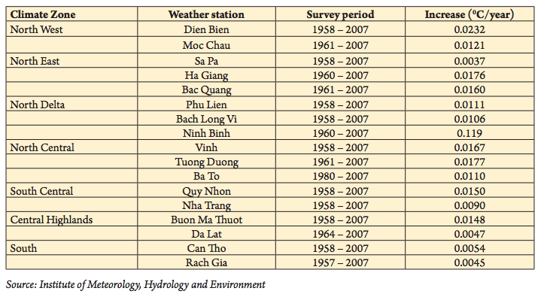
Changing Temperature

Slide 39
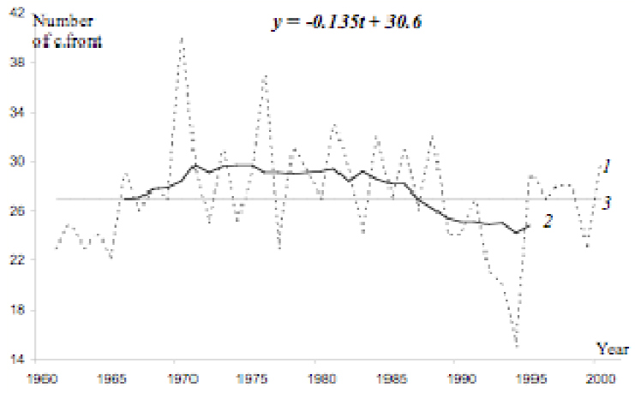
Cold Fronts?
Affect Northern Vietnam
Frequency may be decreasing since 1980

Slide 40
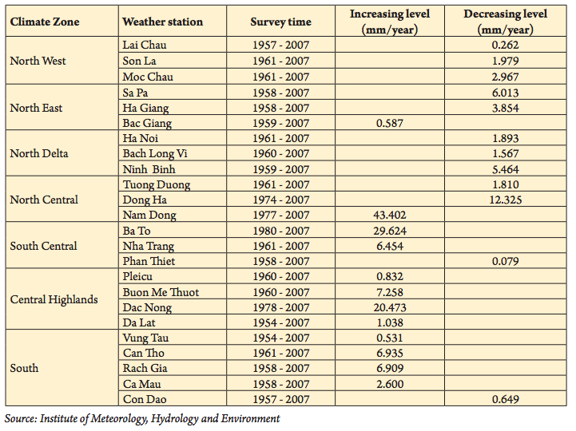
Changing Precip
Small decrease in north
Large increase in south

Slide 41
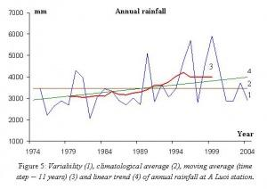
Changing Precipitation
Nearly a 1000 mm increase at this location since 1974
Largest increase August - December (rainy season)
Decreasing trend in June & July

Slide 42
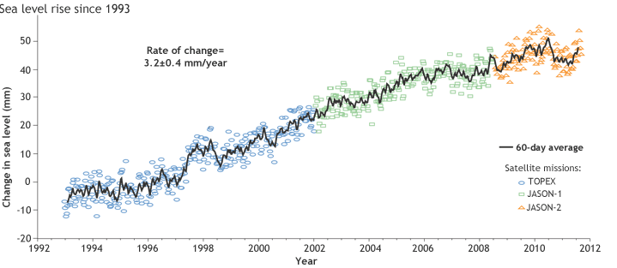
Sea Level Change
+3.2 mm/yr from 1993 to 2008
About 20 cm in the past 50 yrs
Both are consistent with worldwide trends

Slide 43
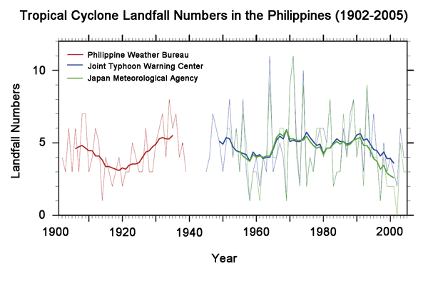
Typhoon Trends
Typhoon frequency cycles, but has remained relatively constant for the past 100 years in the western Pacific
Notes:
In recent years, the number of tropical cyclones on the East Sea is on the rise, while storms and tropical depressions tend to move toward the southern part of the Vietnamese territory. Scientists have noted that the number of very strong typhoons is on the increase, while the storm season ends later than in previous years.
Thanh has noted that the weather tends to me more extreme with storms to appear sooner, stronger every year. In general, the storm intensity, measured by the wind speed, is believed to increase by 2-11 percent.
There would be fewer typhoons with weak or moderate intensity, while there would be more strong typhoons due to the warming of the Earth.
The 11 percent wind speed increase would mean that the damages to be caused by storms would be 60 percent higher. Stronger storms would bring heavier rains, while heavier rains would cause heavier damages.

Slide 44
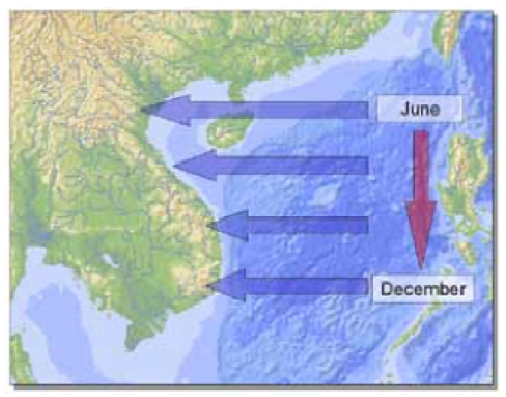
Typhoon Trends
Typically strike further south later in the year
Storm tracks migrating further south
Season shifting to later months of the year

Slide 45
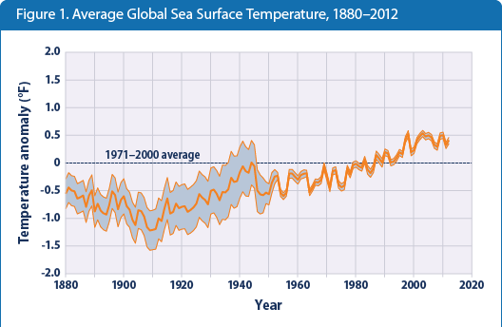
Sea Surface Temps vs Storm Intensity
Sea temperatures approximately 0.3C warmer than 1971 to 2000 average
Tropical cyclone expected to increase intensity 3 to 5% for each 1C increase in sea surface temperature

Slide 46
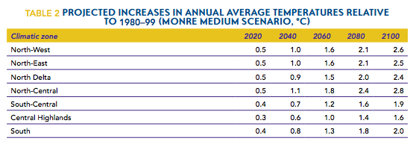
Temperature Projections
+1.6 to +2.8 C by 2100 with the larger increases in the north

Slide 47
Precipitation Projections
+1.4 to +7.9% by 2100 with the larger increases in the north

Slide 48
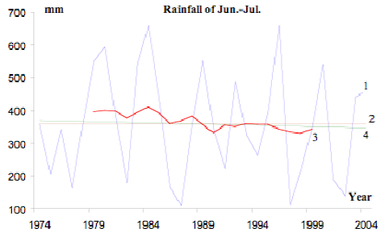
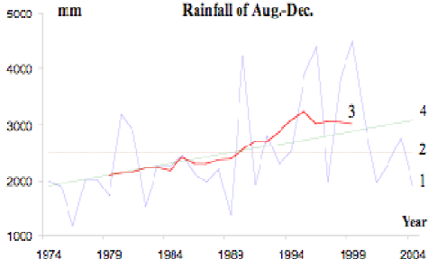
Precipitation Change Projections
Dry season becomes drier w/ greatest reduction in the south (-10 to 15%)
Wet season becomes wetter w/ greatest increase in the north (+10 to 24%)
Even greater difference between dry & rainy seasons
Increased frequency, intensity, and duration of droughts and floods

Slide 49
Sea Level Change Predictions
Increase of 30 cm by 2050
Increase of 75 cm by 2100
under the medium scenario

Slide 50
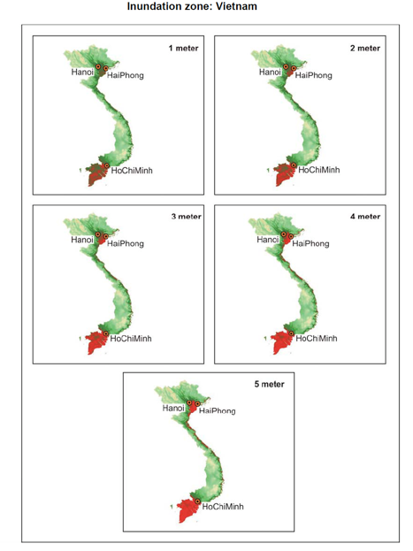
Consequences of Sea Level Change
Submersion of Red River and Mekong River Deltas
Home to 50% of population
Center of rice production

Slide 51
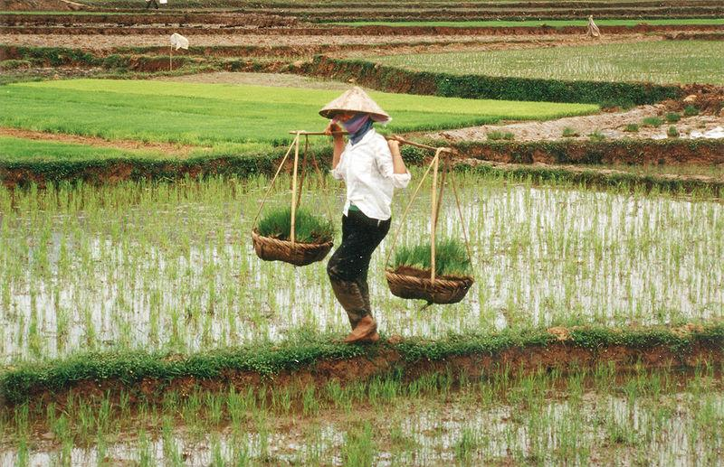
Agriculture Projections
Decreased rice production of 12 to 24% due to increased temperatures and decreased stream flow.
Loss of 590,000 ha (13%) of rice land in Mekong Delta due to saline intrusions during dry season, increased flooding, and sea level rise.

Slide 52
Agriculture Projections
Loss of 9.1 million metric tons of crops by 2050

Slide 53
Technology to the Rescue?
Some of the agricultural impacts may be lessened by:
changing planting dates
developing salt tolerant rice varieties
introducing new crops
rotating crops with farmed fish

Slide 54
Bibliography (needs correct formatting)
Miranda, J. Jaime. "El Niño and Health." The Lancet 363.9404 (2004): 247-48. Web.
"National News Agency - Three Dead as Typhoon Wutip Batters Central Vietnam." National News Agency - Three Dead as Typhoon Wutip Batters Central Vietnam. N.p., n.d. Web. 15 Oct. 2014.
"Oceans." EPA. Environmental Protection Agency, n.d. Web. 15 Oct. 2014.
"State of the Climate: 2011 Global Sea Level | NOAA Climate.gov." State of the Climate: 2011 Global Sea Level | NOAA Climate.gov. N.p., n.d. Web. 15 Oct. 2014.
"Weather Impacts of ENSO." NWS JetStream -. N.p., n.d. Web. 15 Oct. 2014.

Slide 55
Bibliography (needs correct formatting)
http://3.bp.blogspot.com/_EVqlA7ddjC0/TU8TluLEi7I/AAAAAAAAAYg/aWXf8Ykmv-Q/s640/MAPfrappe%2BGoogle%2BMaps%2BMashup%2B-%2BLaos%252C%2BCambodia%2B%2526%2BVietnam%2Bvs%2BUnited%2BStates.png (vietnam & US)
http://media.web.britannica.com/eb-media/33/64633-004-D144C88E.gif (se asia map)
http://www.austinschools.org/campus/oakhill/kirstein/vietnam_world_map.gif (world map)
http://www.mapsofworld.com/lat_long/vietnam-lat-long.html# (latitude map)
http://nephicode.blogspot.com/2011/02/problems-with-malay-theory-part-iv.html (ocean currents)
http://upload.wikimedia.org/wikipedia/commons/7/75/Vietnam_Topography.png (topography)
en.wikipedia.org/wiki/Sa_Pa (height of mountains)
http://vietnamadventurer.com/about-vietnam/vietnam-climate.html (hanoi climate stats)
http://www.srh.noaa.gov/jetstream/tropics/enso_impacts.htm (enso)
http://www.adpc.net/ece/NewsEvents/ElninoImpacts.html (rice irrigation)
http://www.who.int/globalchange/publications/en/elnino.pdf (enso disasters)
http://talk.onevietnam.org/hanoi-under-water-understanding-flood-problem-in-vietnam/ (floods)

Slide 56
http://english.vietnamnet.vn/fms/environment/89161/scientist-admits-natural-calamities-getting-more-unpredictable.html (increasing typhoons)
http://thedevelopmentadvisor.com/asia-coastal-resort-development-rainfall-typhoon-map/ (typhoon map)
http://climatechange.worldbank.org/sites/default/files/documents/EACC_Vietnam.pdf (climate change projections)
http://www.rrcap.ait.asia/lc/cd/html/countryrep/vietnam/result.html (vegetation)
http://www.nna-leb.gov.lb/en/show-news/14666/Three-dead-as-typhoon-Wutip-batters-central-Vietnam (typhoon picture)
http://www.adrc.asia/management/VNM/Vietnam1.html (natural disasters)
http://en.wikipedia.org/wiki/Typhoon_Haiyan (typhoon haiyan)
http://www.yalibnan.com/2013/11/11/philippines-typhoon-haiyan-by-the-numbers/ (haiyan’s path)
http://www.theglobeandmail.com/news/world/explainer-how-are-typhoons-formed/article15373372/ (how typhoons formed)
http://weadapt.org/knowledge-base/national-adaptation-planning/Key-findings-from-Vietnam-NCAP-Project (historic T & P)
http://cgge.aag.org/GlobalClimateChange1e/cs-4/cs-43.html (sea level change)
http://www.climate.gov/news-features/understanding-climate/state-climate-2011-global-sea-level (sea level rise)
http://www.unep.org/pdf/dtie/VTN_ASS_REP_CC.pdf (climate change)
http://www.worldclimatereport.com/index.php/2010/01/14/listening-to-johnny-chan/ (philippine typhoons)
http://www.epa.gov/climatechange/science/indicators/oceans/sea-surface-temp.html (sea surface temp)
http://www.nlcap.net/fileadmin/NCAP/Countries/Vietnam/032135.0503xx.VN.CON-01.Output4_5.final.pdf (precip change)

Slide 57
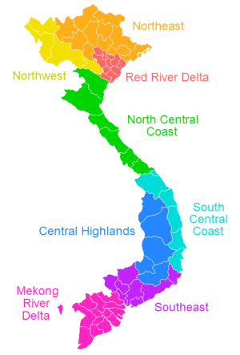
http://upload.wikimedia.org/wikipedia/commons/d/de/VietnameseRegions.png

